Slide 1
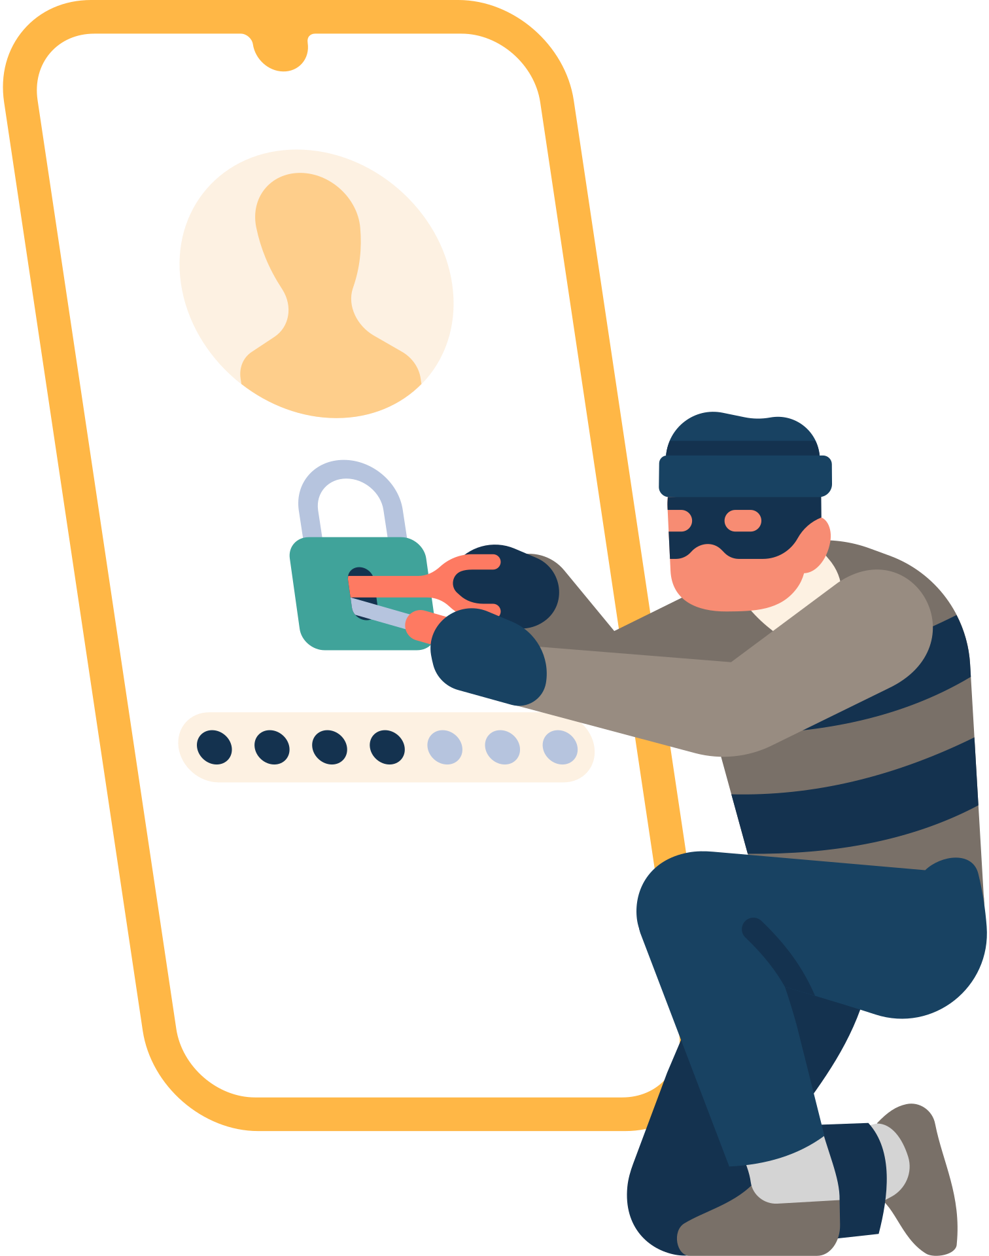


The Spy in your
Phone | Pegasus
"If you want to keep a secret, you must also hide it from yourself.“
:by George Orwell
sandhu2159@saskpolytech.ca
ABC Talks 2022

Slide 2
Content
1). What is Spyware?
2). How Spyware Works & Demo?
3). What is Pegasus?
4). Normal Spyware Vs Pegasus?
5). References
sandhu2159@saskpolytech.ca
ABC Talks 2022

Slide 3
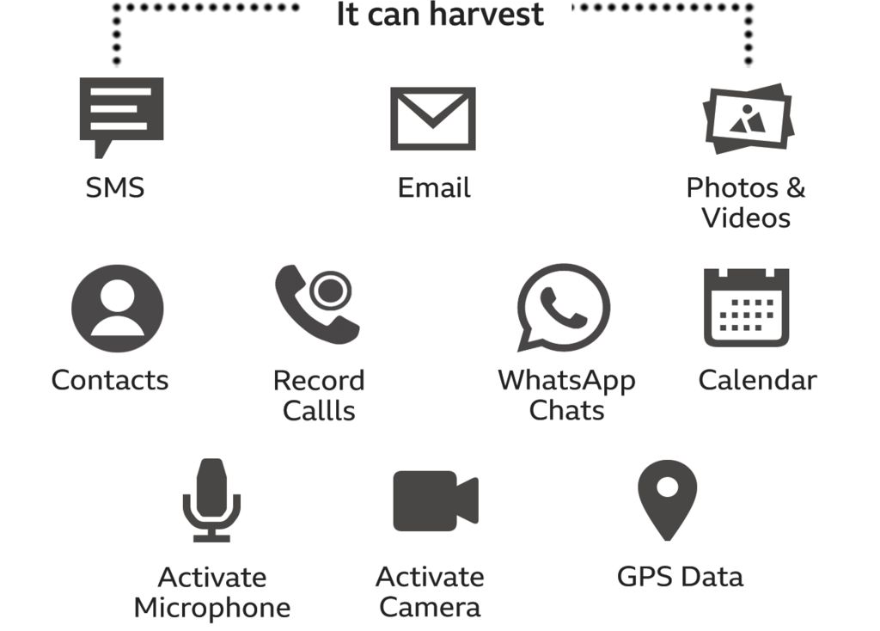


1). What is Spyware?
Spyware is malicious software or application that, once installed on your phone, steals your information and sends it to a third party.
Goal is to gather private information from user's phone.
sandhu2159@saskpolytech.ca
ABC Talks 2022
1

Slide 4
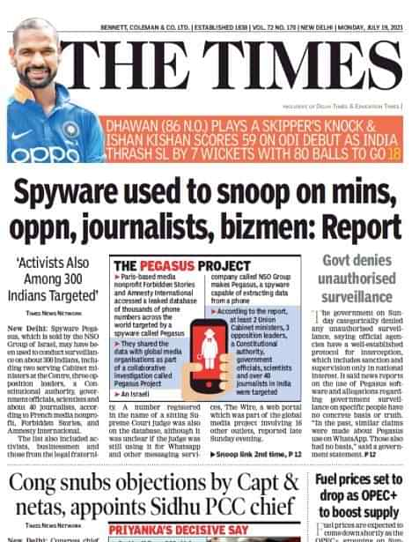
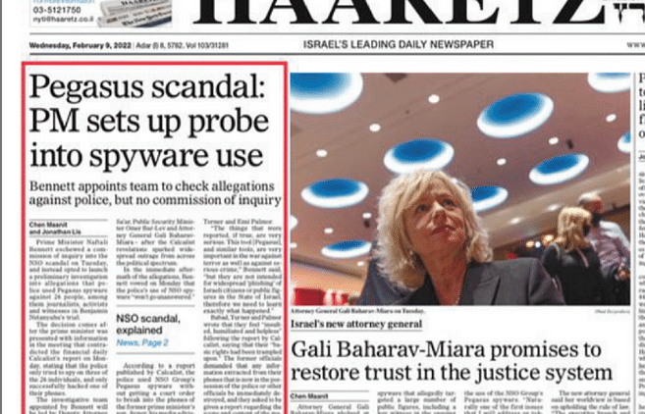
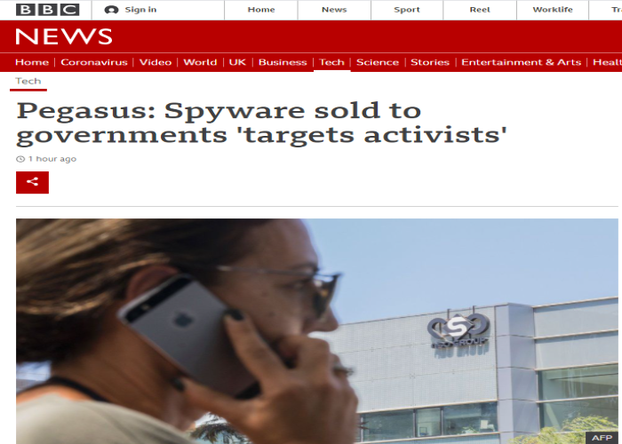
News Articles
https://camera-uk.org/2021/07/20/bbc-news-again-erases-the-british-connection-to-spyware-story/
https://www.nationalheraldindia.com/india/growing-evidence-that-the-indian-state-bought-pegasus-spyware-the-technical-committee-told
sandhu2159@saskpolytech.ca
ABC Talks 2022
2

Slide 5

3). What is Pegasus?
Pegasus is spyware developed by the Israeli company NSO Group.
Spyware that can easily enter a smartphone and gain access to everything on it, including its camera and microphone.
Pegasus silently deploys invisible software ("agent") on the target device.
Installation is performed remotely (over-the-air).
Does not require any action from the target and leaves no traces whatsoever on the device.
NSO Group developed its first Pegasus spyware in 2011.
NSO standing for Niv, Shalev and Omri, the names of the company's founders.
sandhu2159@saskpolytech.ca
ABC Talks 2022
3

Slide 6

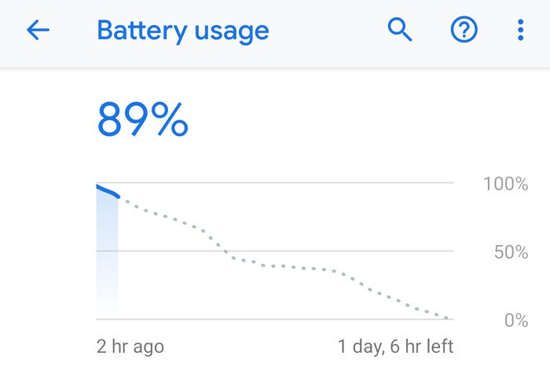

Pegasus Highlights (Perfect mind of hacker)
Penetrates Android, BlackBerry, iOS and Symbian based devices
Accesses password-protected devices
Leaves no trace on the device
Minimal battery, memory and data consumption
Self-destruction functionality in case of exposure risk
Extracts contacts, messages, emails, photos, files, locations, passwords, processes list and more
sandhu2159@saskpolytech.ca
ABC Talks 2022
4

Slide 7
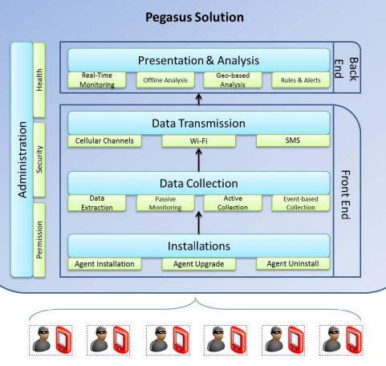
1). Pegasus Architecture
Each agent is independent and is configured to collect different information from the device.
The data is sent back to the Pegasus servers in a hidden, compressed and encrypted manner.
Fig. 1. Pegasus Architecture [1]
sandhu2159@saskpolytech.ca
ABC Talks 2022
5

Slide 8
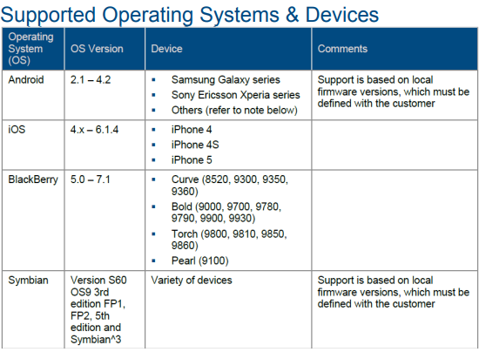
1). Pegasus Supported Devices
Each agent is independent and is configured to collect different information from the device.
The data is sent back to the Pegasus servers in a hidden, compressed and encrypted manner.
Fig. 2. Supported Devices List [1]
sandhu2159@saskpolytech.ca
ABC Talks 2022
6

Slide 9
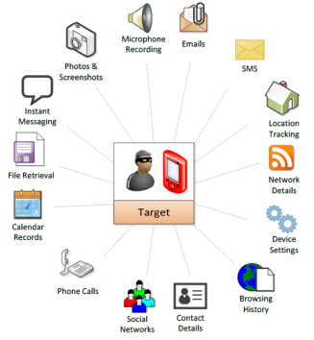
Pegasus Capabilities and Price
NSO charges a flat $500,000 fee for installing Pegasus.
It charges government agencies $650,000 to spy on 10 iPhones.
$650,000 for 10 Android users.
$500,000 for five BlackBerry users.
Fig. 3. Pegasus functionality [1]
https://www.moneycontrol.com/news/india/find-out-the-cost-of-putting-pegasus-into-a-smartphone-for-spying-7200991.html
sandhu2159@saskpolytech.ca
ABC Talks 2022
7

Slide 10
Pegasus Capabilities (hidden space in your phone)
The collected data is stored in a hidden and encrypted buffer.
This buffer is set to reach no more than 5% of the free space available on the device.
For example – if the device has 1GB of free space, the buffer can store up to 50MB.
sandhu2159@saskpolytech.ca
ABC Talks 2022
8

Slide 11
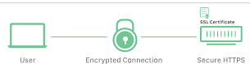
Pegasus Capabilities (sending collected data to hacker)
All connections between the agents and the servers are encrypted with strong algorithms.
Extra care was given to ensure minimal data, battery and memory are consumed within the agents.
This is meant to make sure that no concerns are raised by the target.
sandhu2159@saskpolytech.ca
ABC Talks 2022
9

Slide 12
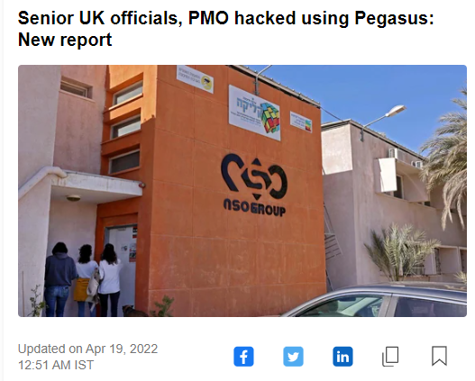
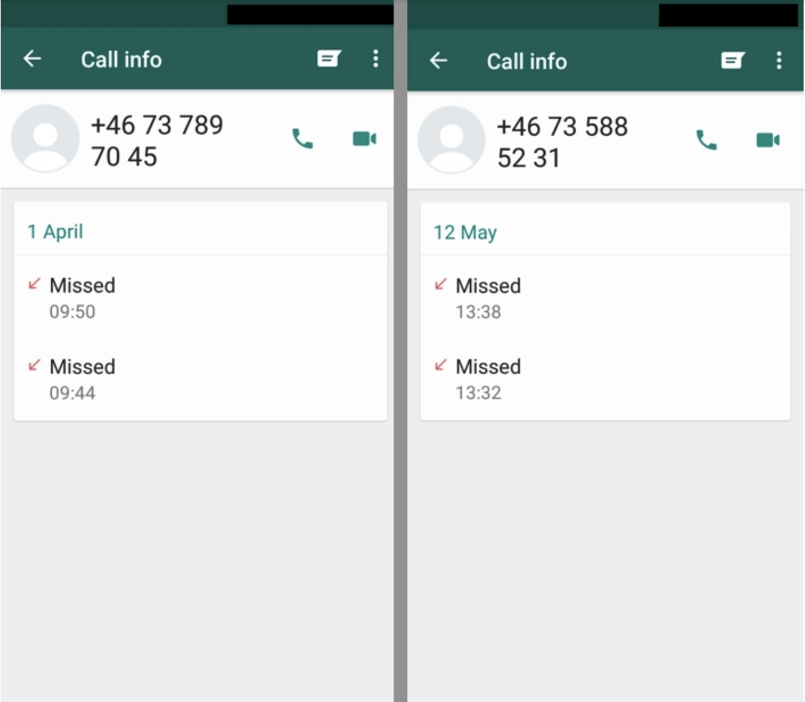
Previous Incidents related to Pegasus
In 2019 WhatsApp NSO’s software hacked more than 1,400 phones. Simply by placing a WhatsApp call.
https://citizenlab.ca/2019/10/nso-q-cyber-technologies-100-new-abuse-cases/
sandhu2159@saskpolytech.ca
ABC Talks 2022
10

Slide 13
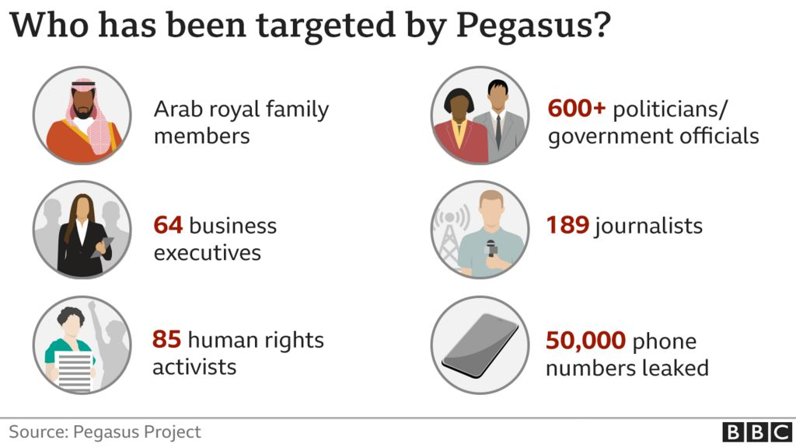
Previous Incidents related to Pegasus
As of Jul 19, 2021, 189 journalists targeted by government clients of NSO company using the spyware Pegasus.
https://citizenlab.ca/2019/10/nso-q-cyber-technologies-100-new-abuse-cases/
sandhu2159@saskpolytech.ca
ABC Talks 2022
11

Slide 14
Tools
Check if device contains Pegasus Spyware files.
Link: https://github.com/z448/pgcheck
Mobile Verification Toolkit (MVT) is a tool for Android and iOS devices, for the purpose of identifying traces of compromise.
Link: https://docs.mvt.re/en/latest/
sandhu2159@saskpolytech.ca
ABC Talks 2022
12

Slide 15
References
DocumentCloud. (n.d.). Www.documentcloud.org. Retrieved April 23, 2022, from https://www.documentcloud.org/documents/4599753-NSO-Pegasus
S. Alok Sir, personal communication, April 2022
‌
sandhu2159@saskpolytech.ca
ABC Talks 2022
13

Slide 16
Thank You
Sahil Sandhu
sandhu2159@saskpolytech.ca
sandhu2159@saskpolytech.ca
ABC Talks 2022
14

